Slide 1
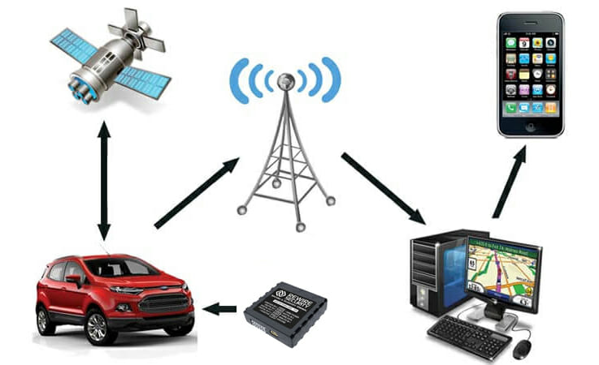





Bonrix GPS Tracking: Precision Tracking Solutions for Modern Businesses
Track and Trace Solutions
Vehicle Tracking
Employee Tracking
Asset Tracking
Real-time Monitoring

Slide 2







Company Overview
Part of Bonrix Software Systems, based in Ahmedabad, Gujarat, India
Providing GPS tracking solutions since 2005
Specializes in vehicle, employee, and asset tracking solutions
Uses advanced GPS/GPRS/SMS technology for precise tracking
Offers comprehensive tracking platform with real-time location updates
Provides cutting-edge IT solutions across multiple domains

Slide 3

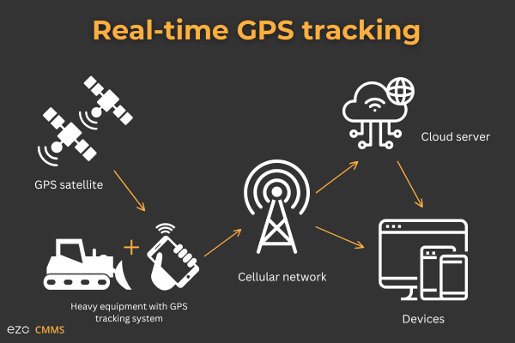


Core Tracking Solutions
Vehicle Tracking
Monitor fleet in real-time with precise location data, speed alerts, and route history
Employee Tracking
Optimize workforce management with location-based attendance and activity monitoring
Asset Tracking
Protect valuable assets with tamper alerts, geo-fencing, and 24/7 monitoring

Slide 4








Key Features
Real-time Tracking
Multi-Map Support
Monitor vehicles, employees, and assets live
Google, OLA, MapMyIndia integration
Geo-Fencing
Route History
Create virtual boundaries with alerts
View complete travel with playback feature
Advanced Reporting
Multilingual Support
Trip, speed, stoppage analysis
Hindi, Gujarati, Marathi & more
Mobile Applications
Track on the go with iOS & Android

Slide 5


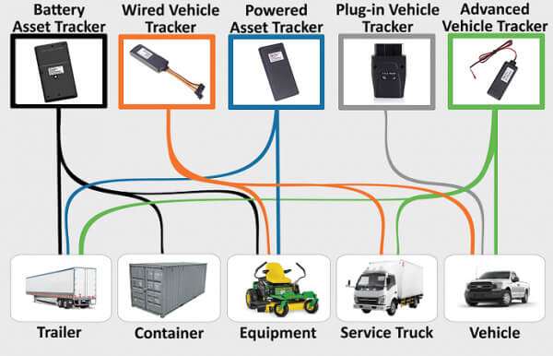




GPS Tracking Devices
Personal Tracker
Vehicle Tracker
Compact and portable for individual tracking
OBD-II and hardwired options available
Asset Tracker
Camera Tracker
Long battery life for valuable assets
Integrated camera for visual monitoring
Mining Tracker
Drone Tracker
Specialized for mining operations
For aerial vehicle tracking

Slide 6


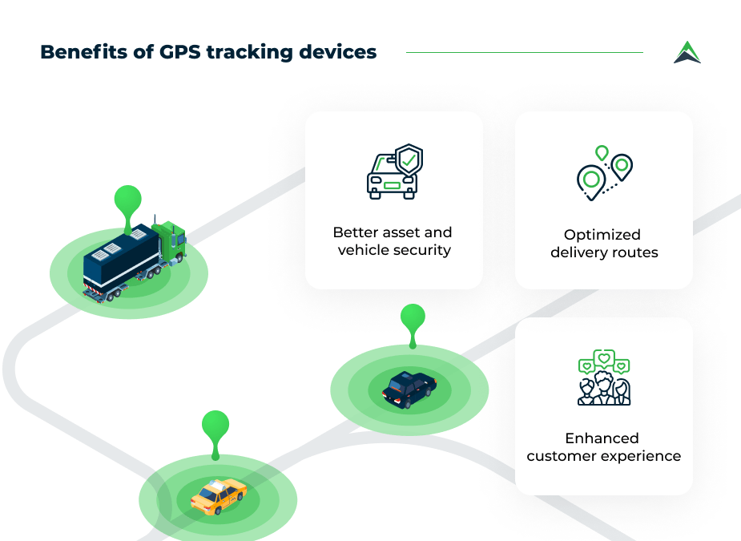




Benefits of Our Solutions
Enhanced Security
Improved Efficiency
Real-time monitoring of vehicles, employees, and assets
Optimize routes and reduce fuel consumption
Cost Savings
Increased Productivity
Reduce operational costs through better resource management
Monitor and improve employee performance
Data-Driven Decisions
Customizable Solutions
Access detailed reports and analytics
Tailored to specific business needs

Slide 7




Contact Us
Address
A-801, Samudra Complex
Near Klassic Gold Hotel
Off C.G.Road, Ahmedabad
Gujarat - 380009, India
Phone
+91-9426045500
+91-9429045500
+91-7624045500
Precision Tracking Solutions for Modern Businesses
Email
gpstracking.co.in
gpstracker.bonrix.in
bonrix.net

